Slide 1



RDBMS & ODBMS
A COMPARATIVE STUDY
page 01
2025

Slide 2



Introduction
page 02
Databases are essential for data management.
Two major types: RDBMS (Relational Database Management System) and ODBMS (Object Database Management System).

Slide 3

What is RDBMS?
Stores data in structured tabular format (rows & columns).
Uses Structured Query Language (SQL) for data manipulation.
Examples: MySQL, PostgreSQL, Oracle, Microsoft SQL Server.
page 03

Slide 4


Features of RDBMS
DATA INTEGRITY & CONSISTENCY
ACID (ATOMICITY, CONSISTENCY, ISOLATION, DURABILITY) COMPLIANCE
page 04
DATA NORMALIZATION
SCALABILITY & SECURITY

Slide 5


What is ODBMS ?
Stores data as objects, similar to object-oriented programming (OOP).
Supports complex data relationships without the need for joins.
Examples: ObjectDB, db4o, Versant.
page 05

Slide 6
Use Cases of RDBMS & ODBMS
RDBMS:
ODBMS:
e-commerce.
Financial systems,
CRM (Customer relationship management)
real-time systems.
Scientific applications,
AI (Artificial intelligence)
page 06

Slide 7

Features of ODBMS
Object Persistence
Direct Mapping to Programming Languages (Java, C++, Python)
Better Performance for Complex Data Structures
Reduces Impedance Mismatch
page 07

Slide 8

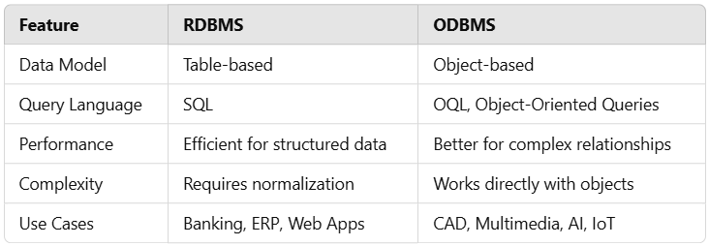
Key Differences Between RDBMS & ODBMS
RDBMS
ODBMS
page 08

Slide 9

Advantages & Disadvantages
RDBMS
✅ Proven, reliable, widely used.
❌ Joins can reduce performance for complex queries.
ODBMS
page 09
✅ Ideal for complex and hierarchical data.
❌ Less standardized, smaller community support.

Slide 10

Conclusion
Summary
RDBMS is best for structured, relational data with SQL queries.
ODBMS is better for object-oriented applications with complex relationships.
Choosing the right database depends on project needs.
page 10

Slide 11
THANK YOU!
MORE INFORMATION: CHANDRIKABIJORE@GMAIL.COM
page 11

